Slide 1
The Second Lab of Computer Network

Slide 2
lab0：
lab0 is postponed to October 10, 23:59, and has the same Deadline as lab1
About the lab report
The language can be Chinese or English
3-5 pages in length, in pdf format
Content: Structure and design, (Optional) Implement challenges, (Optional)Remaining Bugs, Experimental results and performance.
Better to add screenshots as evidence
The report should be placed directly in the root directory (you can ignore the writeups folder)
github：
No need to submit your own GitHub account
The repository can also be set to private (if you are worried about your code being copied)

Slide 3
· Second experimental release: QQ Group
· DDL：Oct 10, 2024, 23:59
· If you refer to other people's code and ideas during the experiment, remember to write them down in the experiment report.
* There is a two-week make-up period after DDL, but the score for the make-up is multiplied by 0.95

Slide 4
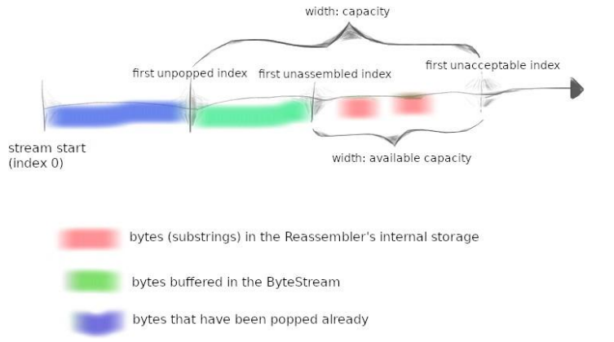
Lab1: Reassembler
In lab0, we implemented a byte_stream class that can be used for reading and writing, with flow control function
We want the bytes to be reliable and in order.
In practice, the data sent by the sender may have the following situations:
Out of order delivery
It may be loss
It may be sent repeatedly

Slide 5
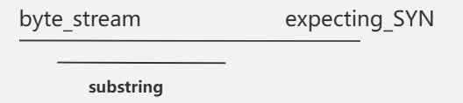
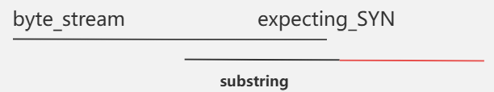
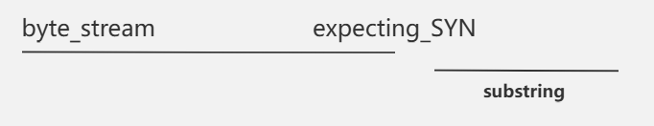
Lab1: Reassembler
When the starting sequence number of the received substring is exactly the sequence number expected by byte_stream
Just consider whether byte_stream can accommodate this substring.
When the starting sequence number of the received substring is not the sequence number expected by byte_stream
If the substring has been inserted into the byte_stream, that is, the tail sequence number of the substring is less than the expected sequence number of the byte_stream, just discard it.
If substring and byte_stream have intersection, that is, the initial sequence number of substring < the expected sequence number of byte_stream < the end sequence number of substring, it seems that a part (the red part in the figure below) can be inserted into byte_stream. But you should also consider carefully whether only the red part can be inserted? (The red part may be connected to the substring in the buffer, and more bytes may be inserted at this time), or it may not be completely inserted (byte_stream capacity is insufficient and needs to be truncated)
If the starting sequence number of the substring is greater than expecting_SYN, a buffer may be needed to temporarily store the substring.

Slide 6
Lab1: Reassembler
Details:
You don't need to consider whether the substring passed to you has byte errors.
Bytes should be delivered as quickly as possible. Once a substring can be inserted into the byte_stream, it should be inserted immediately.
There may be overlaps between substrings.
The substrings in the buffer are unique and non-overlapping. Substrings with overlapping parts should be merged and only one copy should be kept.
The implementation does not involve calls to read()

